Slide 1



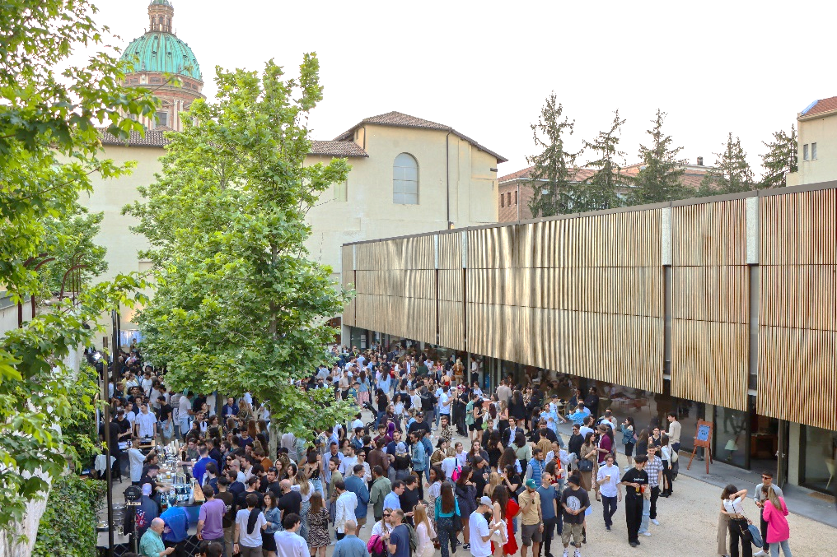
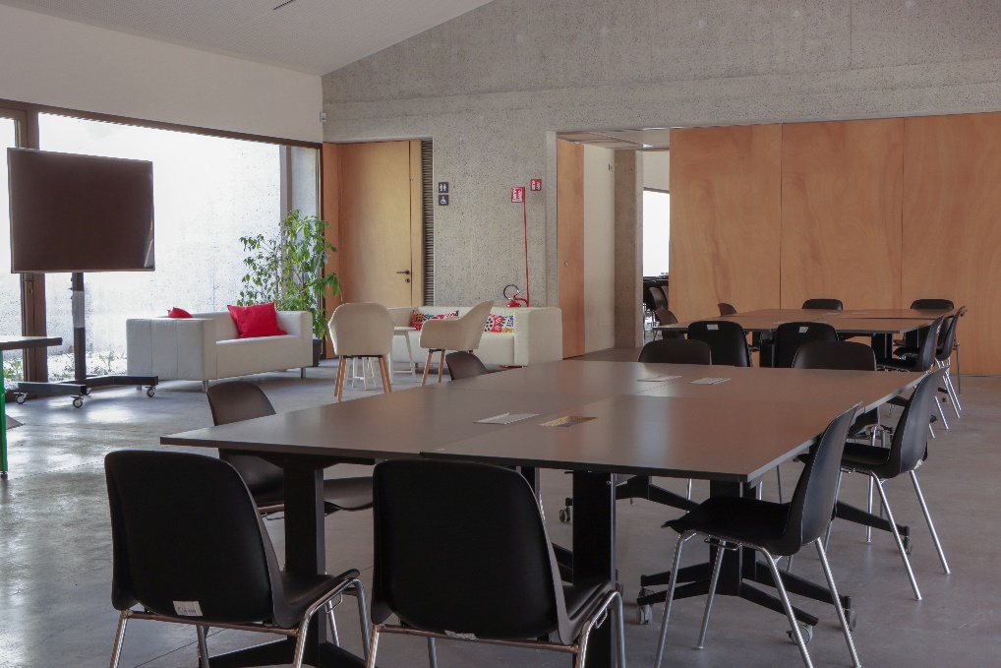
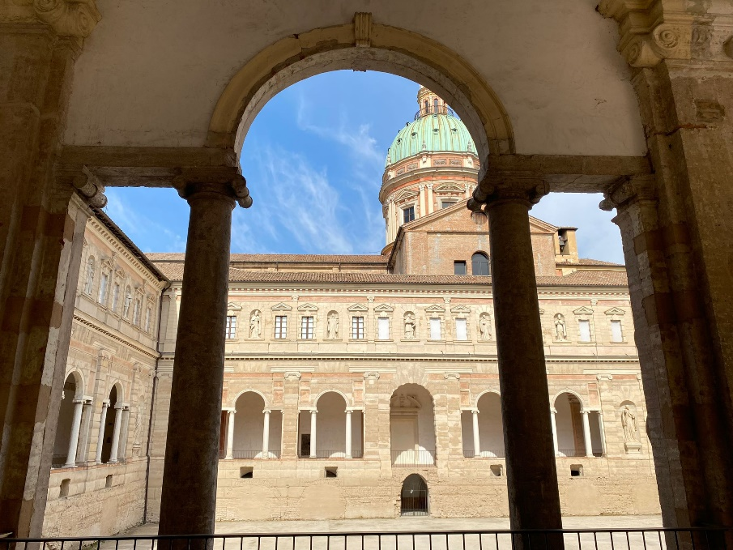
ManuThon 2024 – 3rd edition
Manufacturing Hackathon
April 19 – 20 2024

Slide 2



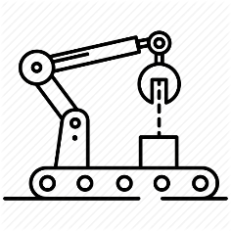




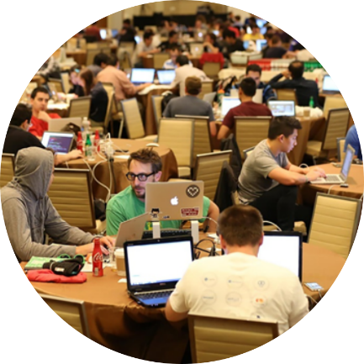


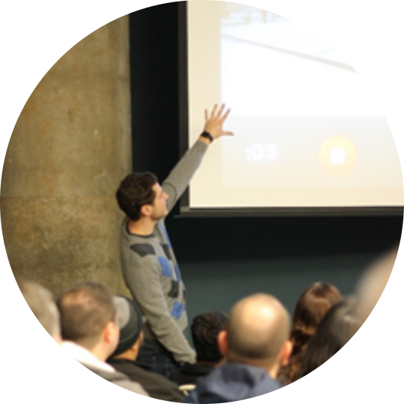




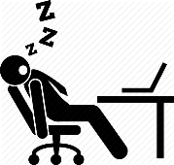


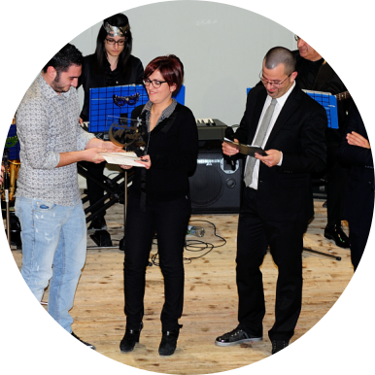


ManuThon: Manufacturing Hackathon
0 - start
According to the Hackathon format, ManuThon is a competition focused on Manufacturing.
Brilliant and selected Youngs from all over Italy
(degree and master degree students, PhD candidates, graduated, etc.) will participate to the competition trying to conceive and develop new ideas in order to reply to the challenges defined by manufacturing industries.
2.5 hours
ideas development
team-working
participants
registration
5 hours
29 hours
challenges
presentation
33 hours - no stop
ideas presentation
The goal of ManuThon is to foster the
date and the interaction between young persons and companies in an unconventional and unformal context.
FREE OF CHARGE
PARTICIPATION
award ceremony

Slide 3
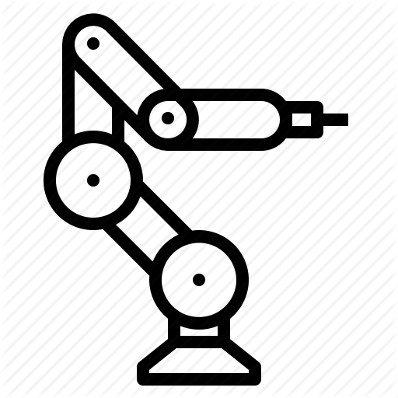
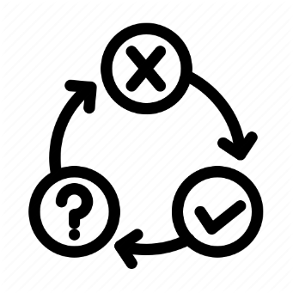







ManuThon in pills
ManuThon is aimed at about 100 participants, brilliant and selected Youngs from the main Italian universities (degree and master degree students, PhD candidates, graduated, etc.) that want to put themselves to the tests with technological challenges proposed by companies.
In a limited time period (33 hours non-stop), the participants should develop a project or propose an idea or conceive a new product or develop an app or a code, etc. to tackle the defined technological challenges
+
24 hours for developing your ideas
time

Slide 4

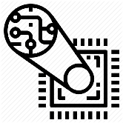


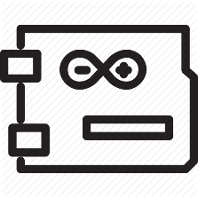







ManuThon in pills
Participants can bring whatever might be useful in the competition of for the final presentation of their ideas (laptop, Arduino©, notes book, camera, equipment for developing apps, etc.)
…
…
you are not able to do
without it…
you are not able to do
without it…

Slide 5



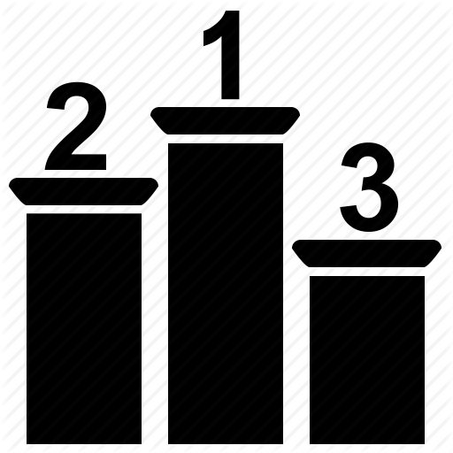



ManuThon in pills
A panel of experts from industries and universities will select the winning team according to their final presentations. The winning team will be awarded a 1500€ prize (global winner). For each challenge (company), there will be even a challenge winner (1000€ )
Participants that conceived and developed interesting ideas could receive further company awards (for instance: payed stage or being involved with the company staff in the development of the conceived ideas).

Slide 6

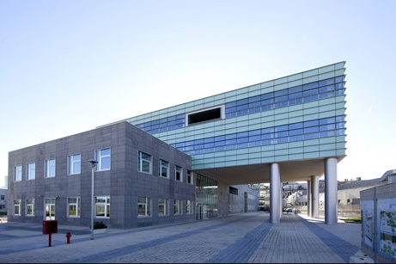

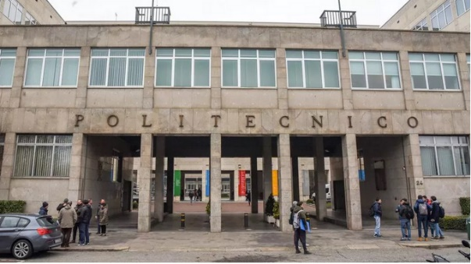
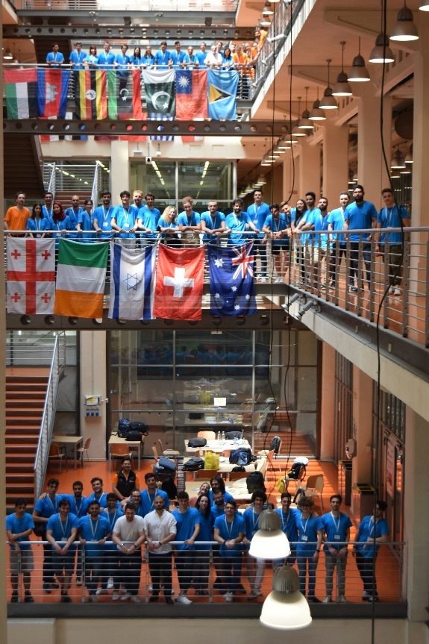
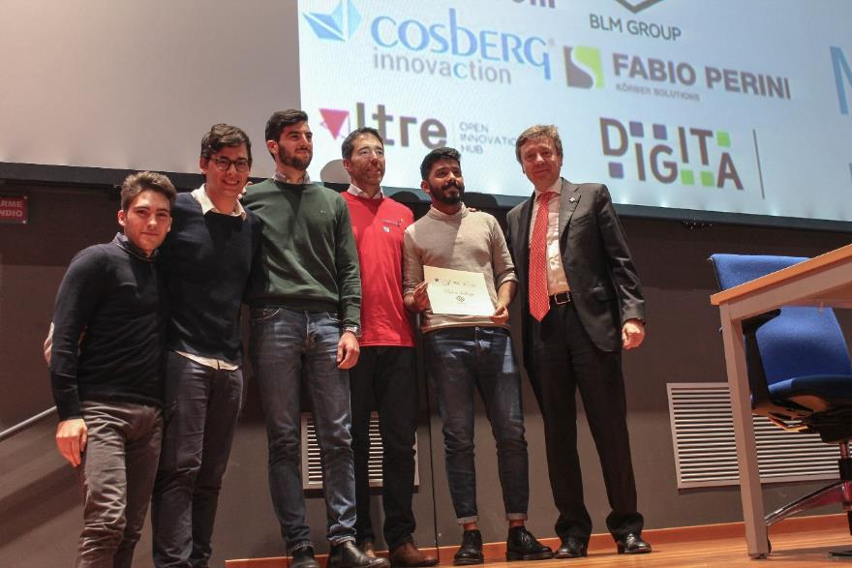






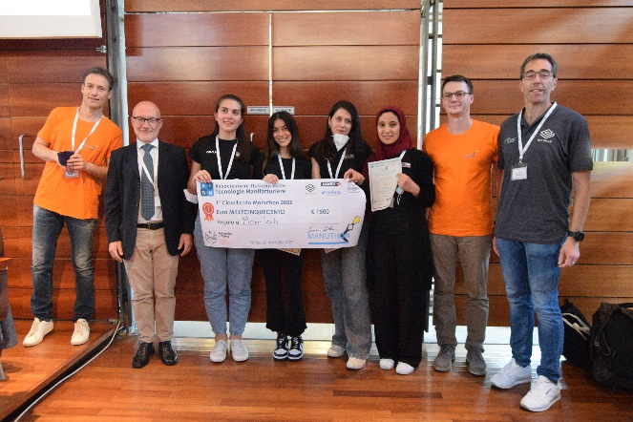

Previous edition: Napoli and Torino
Sponsor companies:
Sponsor companies:
Over 100 partecipants :

Slide 7
First edition: Napoli – Federico II 2019
Sponsor companies:
BLM Group (sector: development of systems for processing tubes, special profiles, and bars such as laser and disk cutting, bending, shaping...) – proposed challenge: Development of an innovative solution for optimizing the cabin of a laser cutting cell for three-dimensional pieces.
MANDELLI (sector: machine tools) – proposed challenge: Development of a methodology for formalizing, structuring, updating, and sharing information related to integration and customization of highly specialized commercial modules and products (e.g., drives, numerical control, PLC, etc.), not only among technicians of the same company but also among technicians belonging to companies operating in the same sector.
COSBERG INNOVACTION (sector: design and construction of machines and modules for automating assembly processes in various fields of application) – proposed challenge: Development of a prototype system (customer-side app and plant builder-side software platform), integrated with software tools, for managing machine failures under the worst conditions, i.e., due to defects not yet coded, and therefore whose solution is not known a priori. The challenge is to design a hypothesis of the process and development of the information sharing system and customer-builder interactions throughout the process, or part of it.
FABIO PERINI – KORBER SOLUTIONS (sector: design and production of industrial machinery for the tissue transformation industry) – proposed challenge: Development of a solution to intercept all best practices and ideas to innovate both the product and the machinery used to produce it in every phase of the life cycle.

Slide 8
Second edition: Politecnico di Torino 2022
Sponsor companies:
BLM Group (sector: development of systems for processing tubes, special profiles, and bars such as laser and disk cutting, bending, shaping...) – proposed challenge: Development of an innovative solution for the workspace of a laser cutting cell for three-dimensional pieces.
DANIELI (sector: global producers of plants and machinery for the metal steel industry) – proposed challenge: Studies and sizing for the simplification of some activities in a technologically advanced context: 1- decide the logic and management of the missions that the A.M.R. must carry out and how they should be executed in a dynamic environment. 2- size the necessary quantity of loading and unloading stations that each workstation should have for smooth operation, 3- size and design, based on the size and weight that the different tools can have, one or more types of trolleys that the A.M.R. will use for transportation.
KORBER TISSUE (sector: design and production of industrial machinery for the tissue transformation industry (paper industry)) – proposed challenge: Development of a solution to monetize and generate revenue from their customers' data, to anticipate and identify customer needs starting from the analysis of their data.
COSBERG INNOVACTION (sector: design and construction of machines and modules for automating assembly processes in various fields of application) – proposed challenge: Realize a model of servitization of Cosberg's customized plants that include management systems, plant lifecycle control systems, and anything deemed necessary and useful.

Slide 9
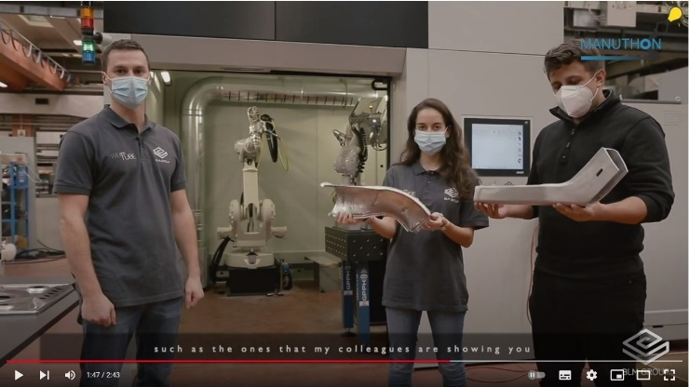
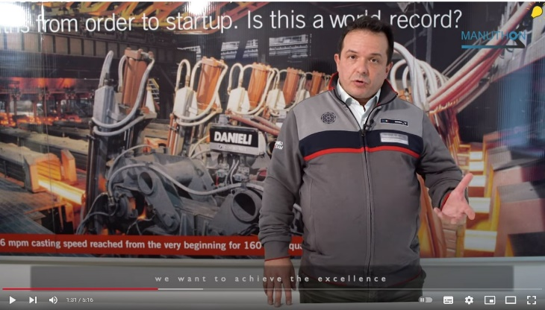
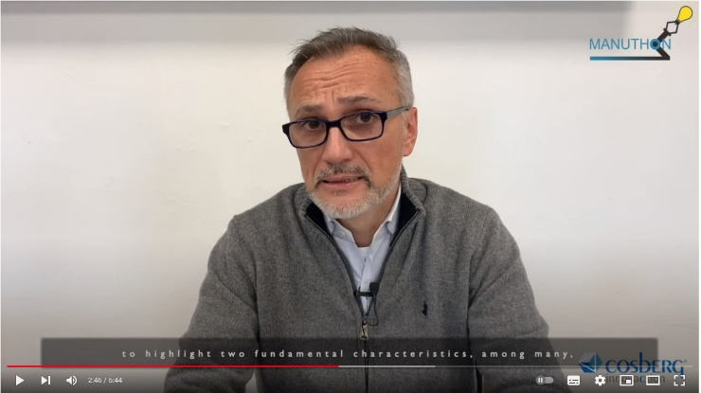
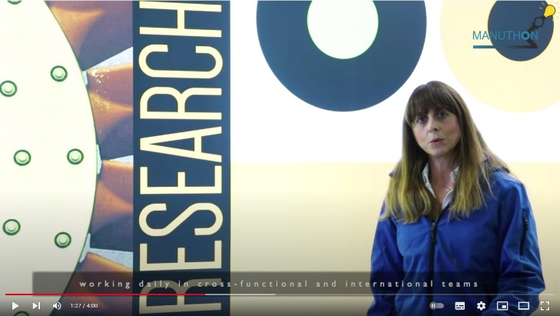
Challenge Manuthon 2022
https://www.youtube.com/watch?v=ouRjXytP8F8
https://www.youtube.com/watch?v=IfIlQ4YJn7M&t=91s
https://www.youtube.com/watch?v=X6Kz16PwSjs
https://www.youtube.com/watch?v=oyp1rmsmVDk

Slide 10








Preparatory workshops
To whom it may concern, preparatory workshop will be arranged. It would be possible to attend the workshop in streaming. These workshops will help preparing the participant to the competition.
(additional information will be available at the website www.manuthon.it).

Slide 11
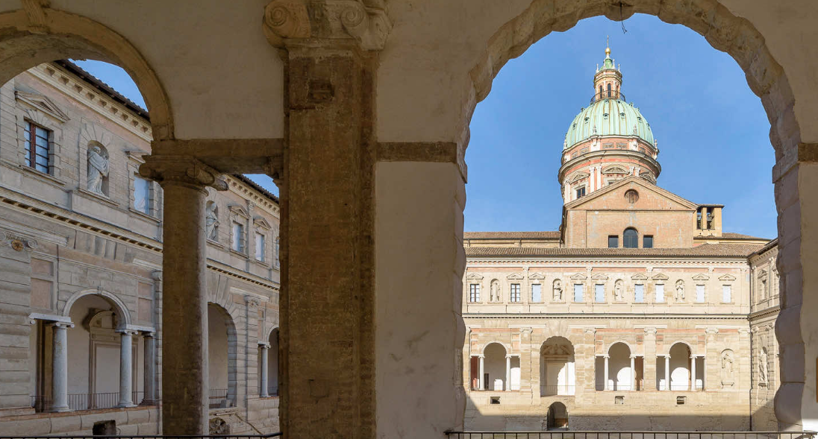
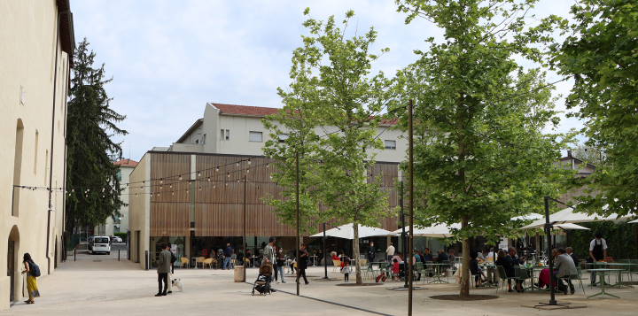
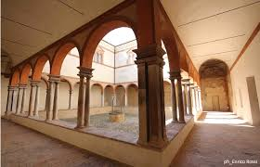
Location 2024 edition
Reggio Emilia and Laboratorio Aperto dei Chiostri di San Pietro
The Chiostri di San Pietro are the most extraordinary monumental complex in Reggio Emilia, one of the most evocative in the Italian Renaissance, bearing the unmistakable touch of Giulio Romano.
It is an ancient monastery that has been used in various ways over the centuries and then remained inaccessible, in the historic center of the city, until the moment of rediscovery and public recovery.
Spaces for Manuthon event at the former stables of the Chiostri di San Pietro.

Slide 12
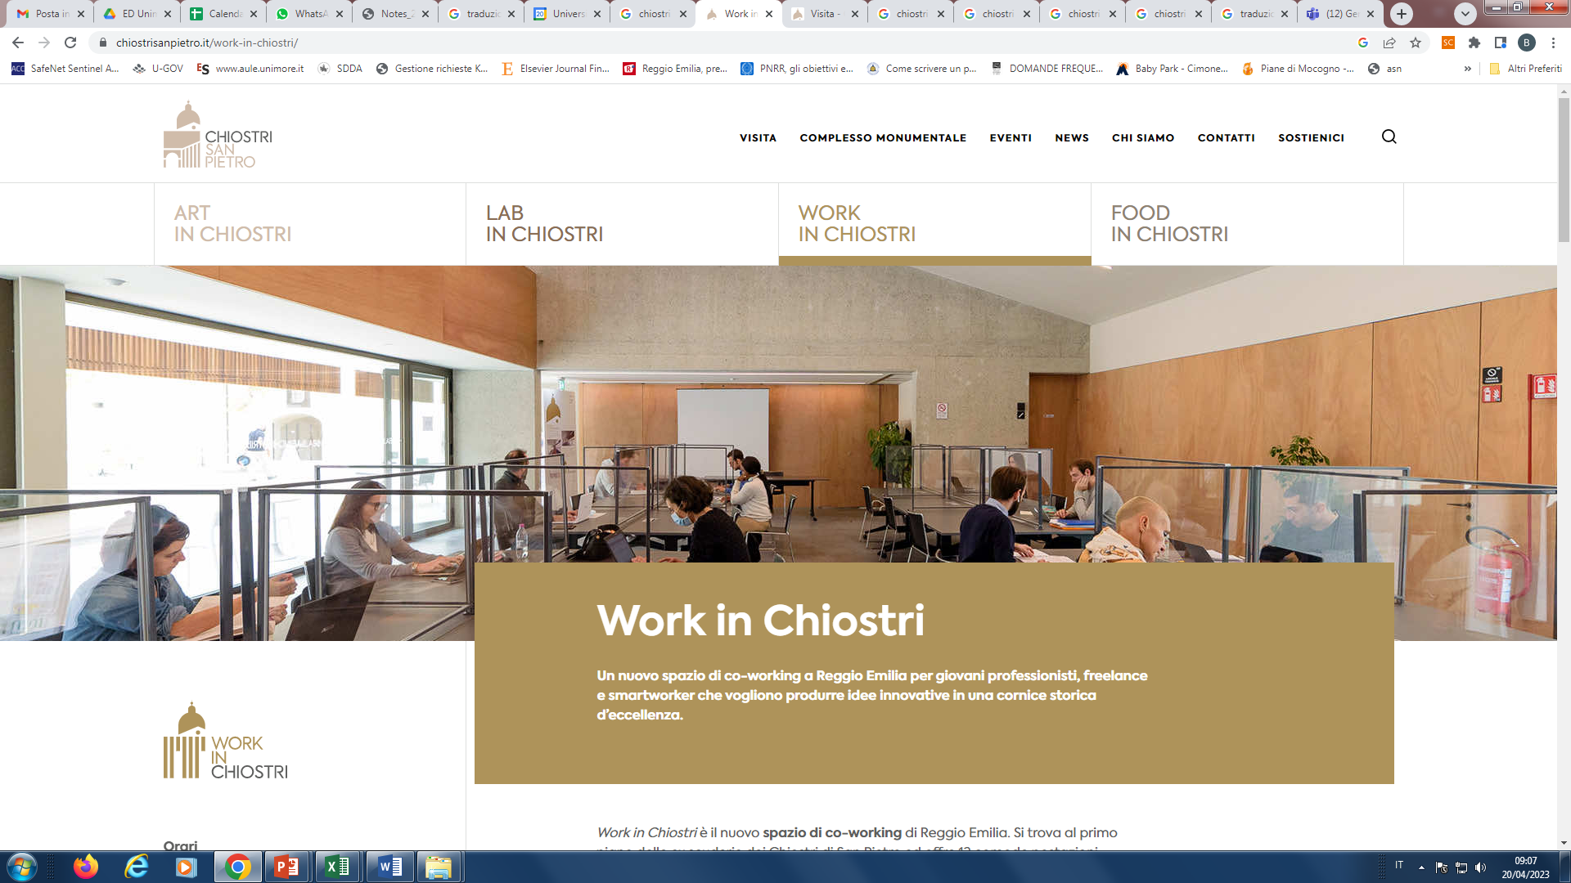
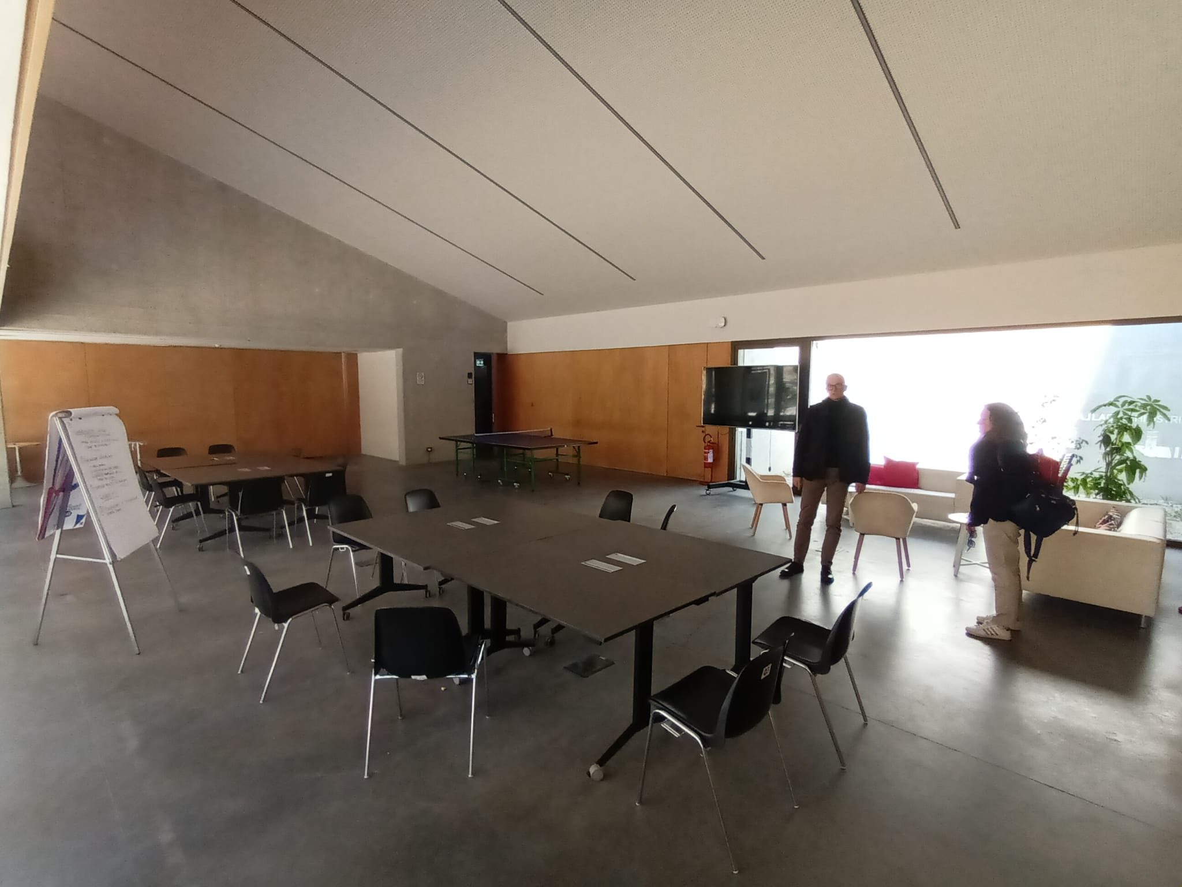
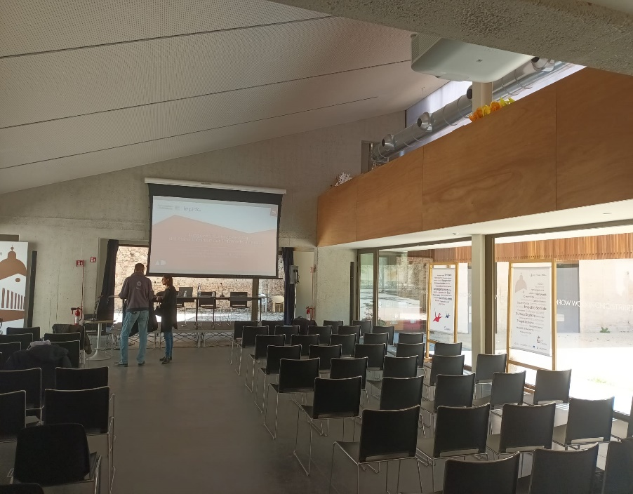
Location 2024 edition
Reggio Emilia and Laboratorio Aperto dei Chiostri di San Pietro

Slide 13
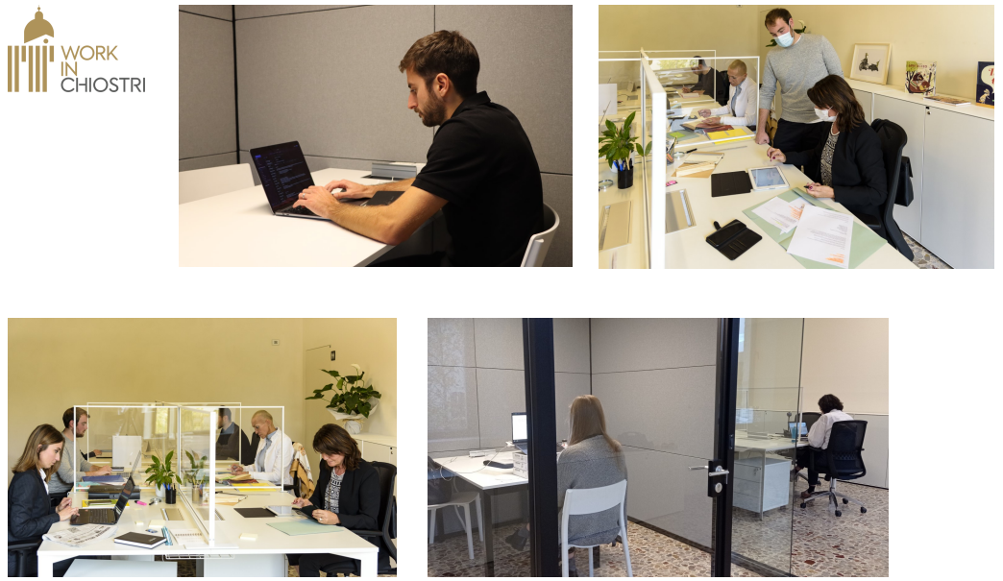
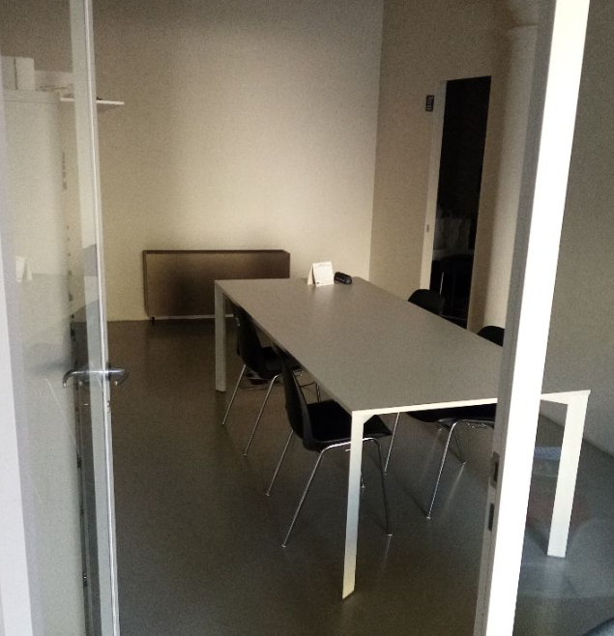
Location 2024 edition
Reggio Emilia and Laboratorio Aperto dei Chiostri di San Pietro

Slide 14




Sponsor companies
SLM solutions
76Industrial graphics
Consorzio 5GTimber
Vimi Fasteners
Sacmi

Slide 15
Logistics
19/04/2024
8.30: starting registration
11.00 Presentation of ManuThon rules and challenges
Start competition: 13:15 (19/04/2024)
End competition: 13:15 (20/04/2024) (24 hours).
During the competition, food and beverage will be provided
13:50 – 17:00 (20/04/2024) Projects presentation
17:20 (20/04/2024) Projects evaluation and award ceremony

Slide 16

If you want to know more…
If you want to keep you up to date…
If you want to send your application…
Visit the website:
www.manuthon.it
Facebook profile:
Manuthon – Manufacturing Hackathon

